Slide 1

Pecunia Bank Management
By
K.Rohith kumar

Slide 2
Transaction Module
Transactions Using Cheque
Here Crediting and Debiting the amount is done by account Number mentioned in cheque.
After Crediting or Debiting the amount from the account the transaction details will be updated in transaction table and Account Balance is Updated in respective Account.

Slide 3

As an Employee I can make debit transactions using cheque
As an Employee I can make credit transactions using cheque

Slide 4
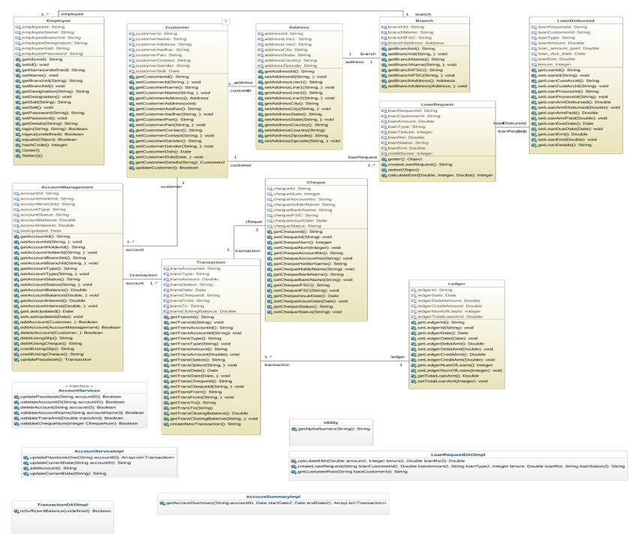
Class Diagram

Slide 5
Class Diagram of Transactions Using Cheque
Account Details
AccountId String
AccountBalance Double
oner
​ Account Details​
AccountId String​ AccountBalance Double​ ​LastUpdate Date
Cheque​
chequeId String​ chequenum String ​ chequeAccountNo String​ chequeHolderName String​ chequeBankName String​ chequeIFSC String​ ​
​ Transaction​
transactionId String​ transAccountId String ​ transType String ​ transDate Date​ transAmount String​ transFrom String​ transTo String​ transOption String ​ transClosingBalance Double

Slide 6
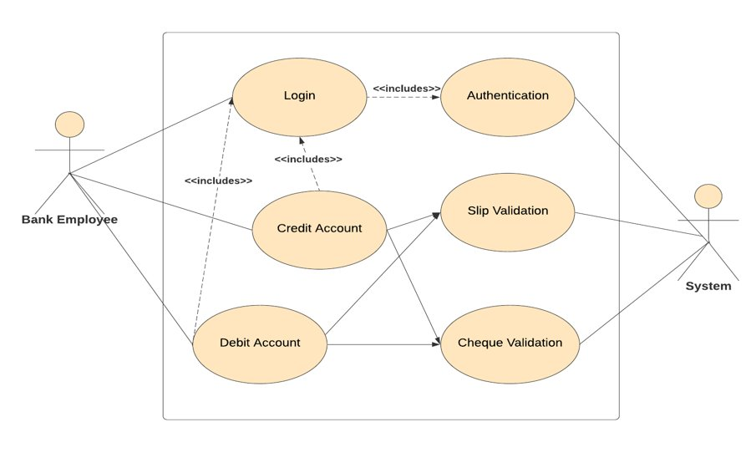
Use Case Diagram

Slide 7
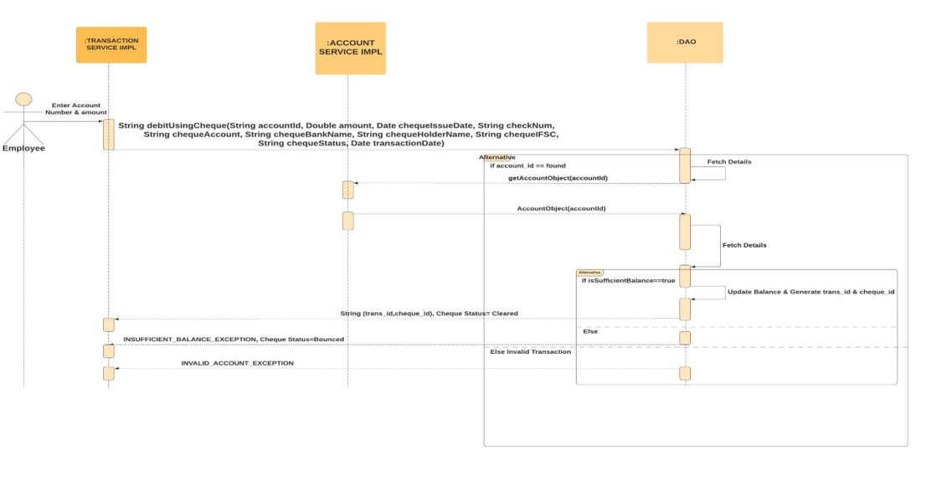
Sequential Diagram of Debit Using Cheque

Slide 8
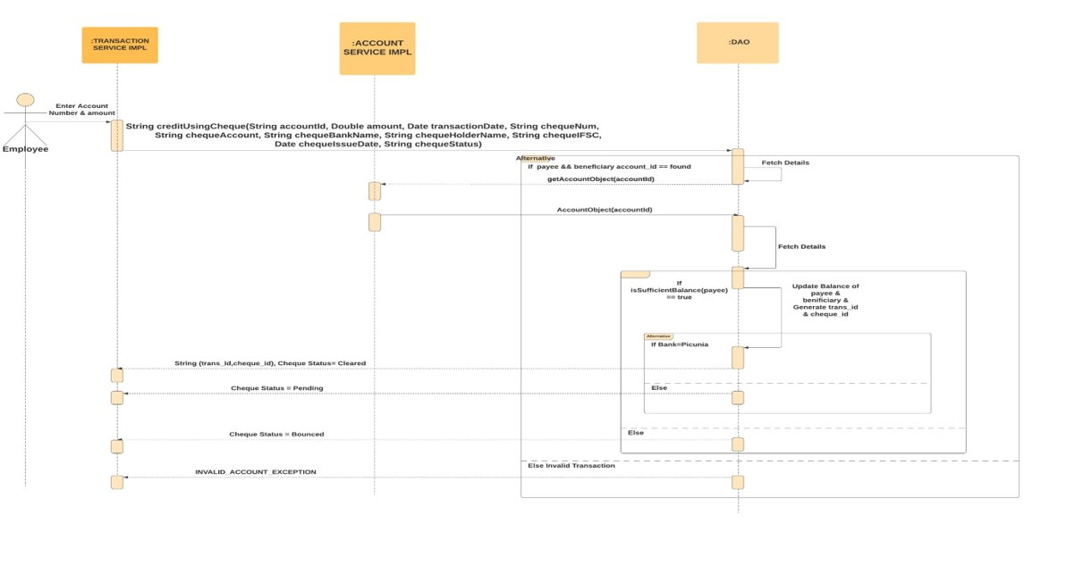
Sequential Diagram of Credit Using Cheque

Slide 9
Thank You

